Slide 1





Zero-Shot Video Question Answering via Frozen Bidirectional Language Models
Antoine Yang, Antoine Miech, Josef Sivic, Ivan Laptev, Cordelia Schmid
Project page: https://antoyang.github.io/frozenbilm.html
Paper: https://arxiv.org/abs/2206.08155

Slide 2
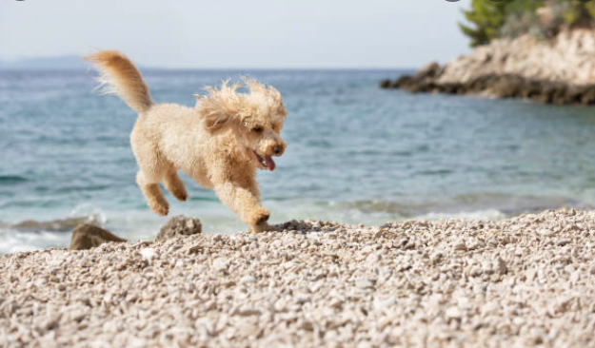

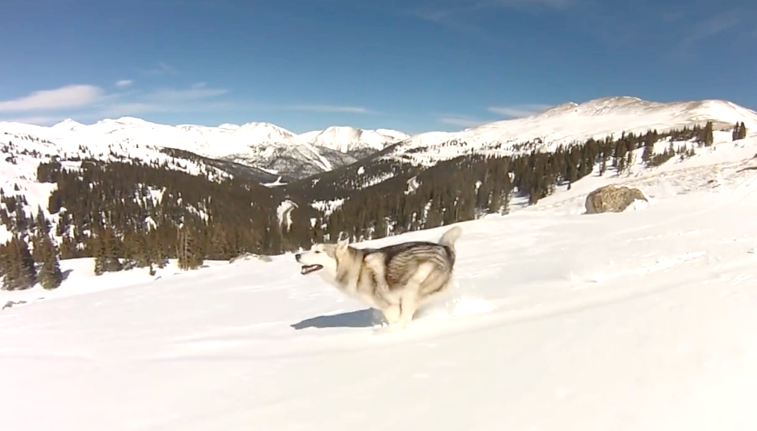
Zero-Shot VideoQA [1]
Cross-modal Training
Training data:
Web-scrapedVideo + Caption
FrozenBiLM
Pretrained BiLM
Little cute toy poodle dog
running fast on the beach.
Zero-Shot VideoQA
Test data:
Video Question
FrozenBiLM
Pretrained BiLM
+
What is the dog doing?
Answer: Running
[1] Just Ask: Learning to Answer Questions from Millions of Narrated Videos, A. Yang et al, ICCV 2021.

Slide 3
FrozenBiLM idea
Background: SoTA models for zero-shot VQA rely on frozen autoregressive language models [2].
Issues: They require billion parameters to work well => hard to train and deploy in practice.
Problematic: Can we tackle zero-shot VideoQA with lighter models?
Idea: Use bidirectional language models (BiLM)!
Autoregressive language models
Bidirectional language models (BiLM)
[BOS] -> The
The -> dog
The dog -> is
The dog is -> running
The dog is running -> in
The dog is running in -> the
The dog is running in the -> snow
The dog is running in the snow -> EOS
The dog is [MASK] in the snow -> running
[2] Multi-modal Few-Shot Learning with Frozen Language Models, M. Tsimpoukelli et al, NeurIPS 2021.

Slide 4
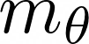

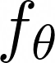

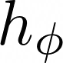

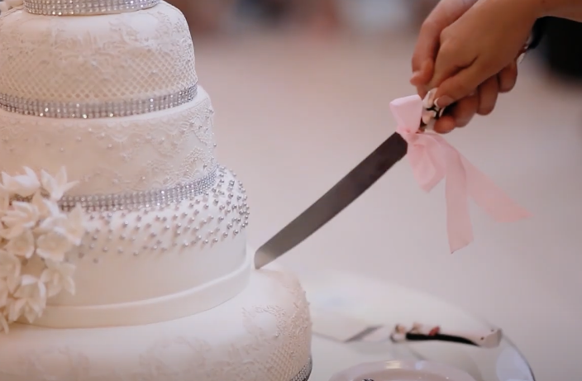
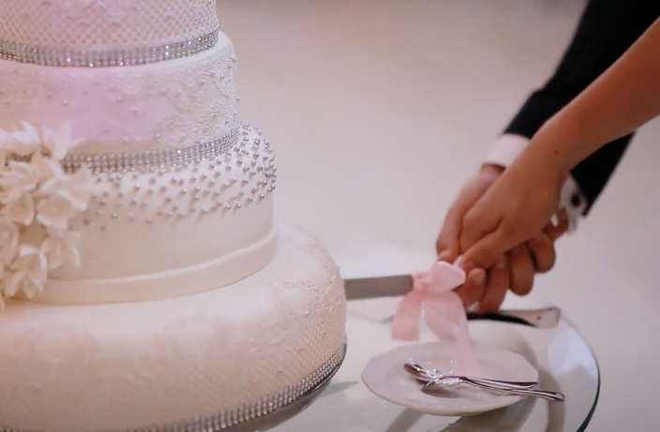
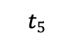
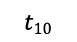
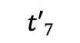
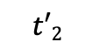
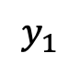

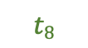
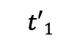
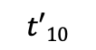
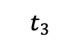
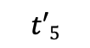
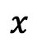
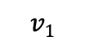
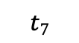
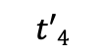
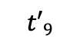
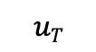
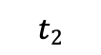
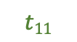
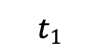

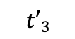
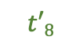
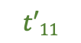
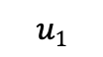
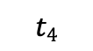
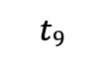
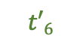
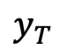
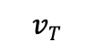
Multi-modal adaptation of a Frozen BiLM
Frozen
cut
cake
wedding
Trained
MLM
MLM
MLM
$$t′1$$
$$t′2$$
$$t′3$$
$$t′4$$
$$t′5$$
$$t′6$$
$$t′7$$
$$t′8$$
$$t′9$$
$$t′10$$
$$t′11$$
Add & Norm
Transformer Encoder (Language Model) with Adapters
Adapter
Feed-Forward
$$v1$$
…
$$vT$$
Visual-Text Projection
…
Visual-Text Projection
$$t1$$
$$t2$$
$$t3$$
$$t4$$
$$t5$$
$$t6$$
$$t7$$
$$t8$$
$$t9$$
$$t10$$
$$t11$$
$×$N
$$u1$$
$$uT$$
Add & Norm
Visual Backbone
…
Visual Backbone
Token Embedder
Adapter
Self-Attention
…
The
bride
and
the
groom
[MASK]
the
[MASK]
at
the
[MASK]
Caption
$$x$$
Frame 1
$$y_{1}$$
…
Frame T
$$y_{T}$$

Slide 5
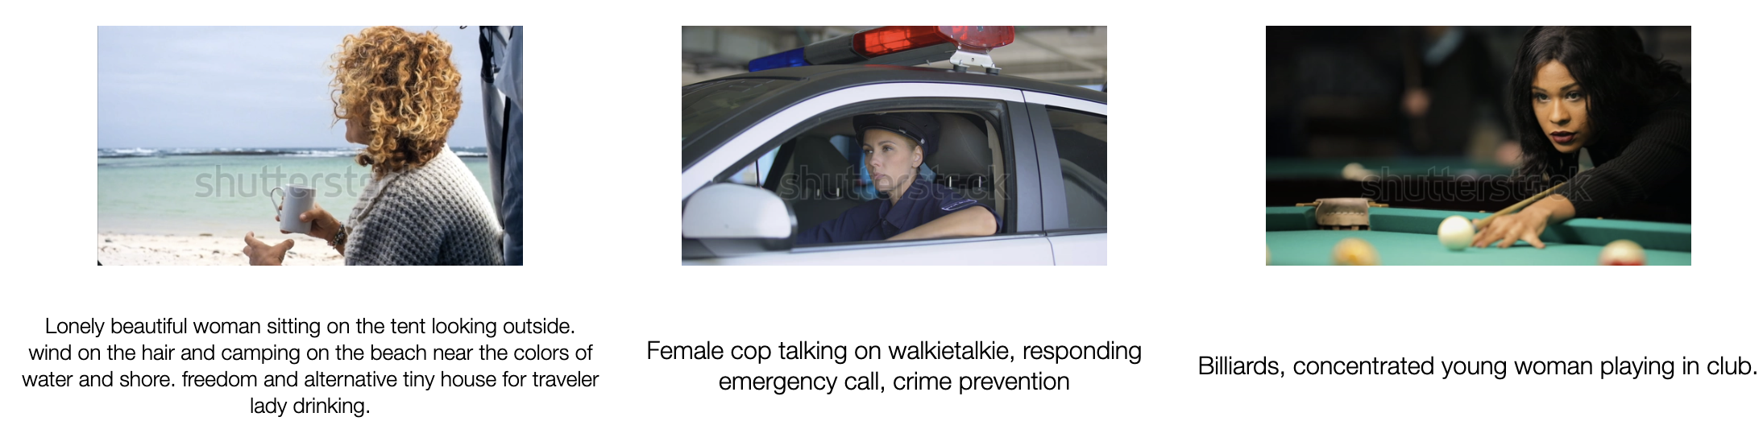
Training data
Initialization of the frozen modules: DeBERTa-V2-Xlarge (900M params) [3] for the BiLM, CLIP ViT-L/14 @224px [4] for the visual backbone.
Training data: Videos with alt-text description from the WebVid10M. Such data are easy to obtain at scale and less noisy than narrated videos [5].
[3] DeBERTa: Decoding-enhanced BERT with Disentangled Attention, P. He et al, ICLR 2021.
[4] Learning transferable visual models from natural language supervision, A. Radford et al, arXiv 2021.
[5] Frozen in Time: A Joint Video and Text Encoder for End-to-End Retrieval, M. Bain et al, ICCV 2021.

Slide 6
Downstream task adaptation
Answer prediction: We map the masked token in the following prompts with an answer embedding module which is initialized from the frozen masked language modeling head.
Open-ended VideoQA:
Multiple-choice VideoQA:
Video-conditioned fill-in-the-blank:

Slide 7
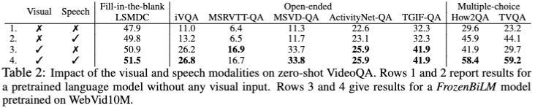
Ablation: Modalities
Vision is essential.
Speech helps.

Slide 8
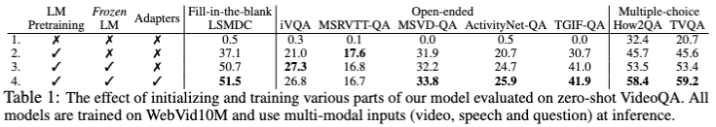
Ablation: Model Training
Freezing the pretrained BiLM considerably helps.
Adapters help.

Slide 9
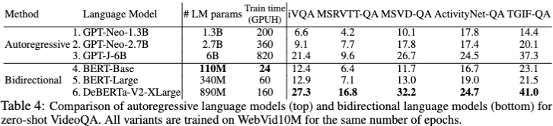
FrozenBiLM vs autoregressive LM
Bidirectional models perform better, train faster and require less parameters.

Slide 10
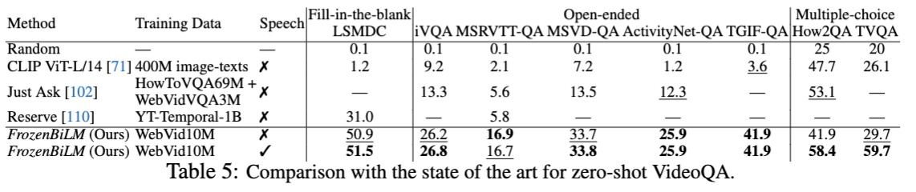
Zero-shot quantitative results
SoTA on 8 datasets spanning video-conditioned fill-in-the-blank, open-ended VideoQA and multiple-choice VideoQA.

Slide 11
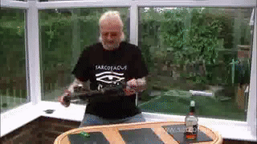
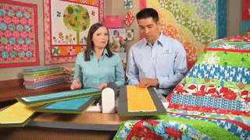

Zero-shot qualitative results (open-ended)
Question: What is the man holding at the start of the video?
GT answer: guitar, electric guitar
Just Ask [1]: typewriter
UnFrozenBiLM: beer
FrozenBiLM (text-only): scissors
FrozenBiLM: guitar
Question: What item hanging on the wall features a tree?
GT answer: quilt
Just Ask [1]: christmas tree
UnFrozenBiLM: fabric
FrozenBiLM (text-only): tree
FrozenBiLM: quilt
Question: Which category of sports does this sport belong to?
GT answer: surfing
Just Ask [1]: second
UnFrozenBiLM: swimming
FrozenBiLM (text-only): 1
FrozenBiLM: surfing

Slide 12
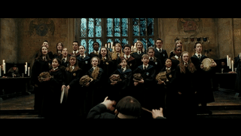

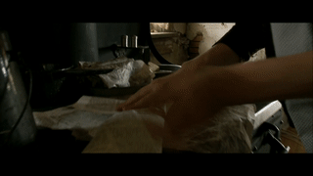
Zero-shot qualitative results (fill-in-the-blank)
Sentence: Each singer in the front row ____ a huge toad.
GT answer: holds
UnFrozenBiLM: plays
FrozenBiLM (text-only): wears
FrozenBiLM: holds
Sentence: Someone ____ him to the truck and across the street.
GT answer: chases
UnFrozenBiLM: follow
FrozenBiLM (text-only): drags
FrozenBiLM: chases
Sentence: A woman wraps food in newspapers and brings it over to their ____.
GT answer: table
UnFrozenBiLM: man
FrozenBiLM (text-only): home
FrozenBiLM: table

Slide 13
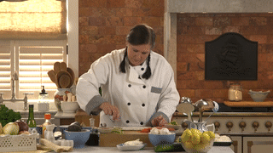
Zero-shot qualitative results (multiple-choice)
Question: When did the chef flipped over the layer of rice and seaweed?
GT answer: A0
A0: after she sprinkled sesame
A1: after she added cucumber
A2: after she added fish
A3: after she cut the cucumbers
UnFrozenBiLM: A3
FrozenBiLM (text-only):A1
FrozenBiLM: A0

Slide 14
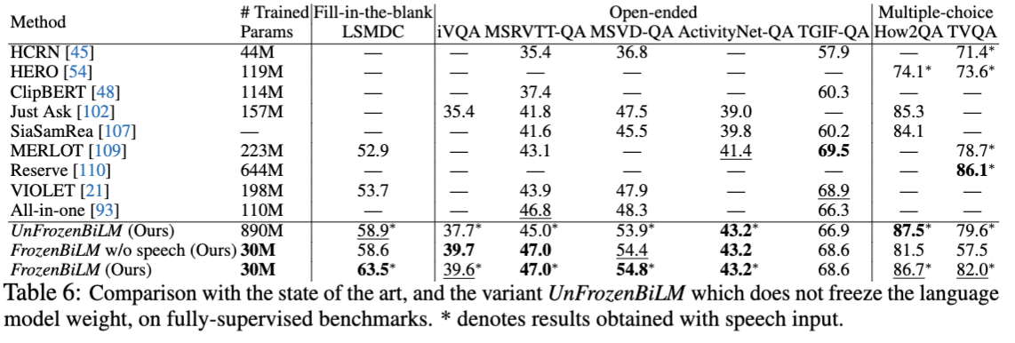
Fully-supervised results
Freezing the BiLM also helps in the fully-supervised setting.
Competitive performance + high parameter efficiency.

Slide 15
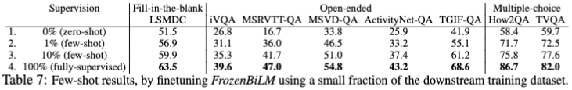
Few-shot results
Significant improvements over zero-shot when using 1% of the downstream training data for finetuning.

